Slide 1

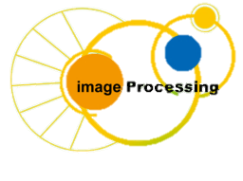
C Programing
Prof. John Y. Chiang
Dept. of Computer Science & Engineering
National Sun Yat-sen University
chiang@cse.nsysu.edu.tw
http://image.cse.nsysu.edu.tw

Slide 2
Contents
1 C Overview
2 Selection and Decision
3 Repetition and Loops
4 Function
5 Arrays
6 Pointers I
7 Pointers II
8 Structure
9 Link list
10 Class and object
I Number system

Slide 3
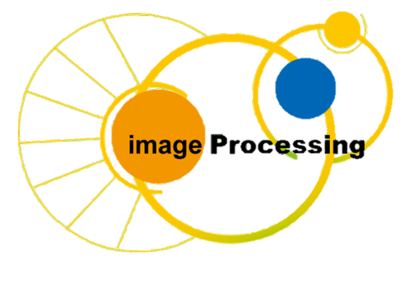
Lecture 8
Structure

Slide 4
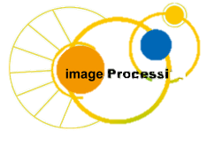
Outline
Introduction
Structure Definitions
Initializing Structures
Accessing Members of Structures
Using Structures with Functions
typedef

Slide 5
Introduction
Structures
    Hold variables of different data types
    Pointers and structures facilitate the formation of complex data structures such as linked lists, queue, stack

Slide 6
Structure Definitions
Structure definition
        struct Card {
        char *face;
        char *suit;
        };
    Keyword struct
    Card is structure name
        Used to declare variable of structure type

Slide 7
Structure Definitions
    Data/functions declared within braces
        Structure members need unique names
        Structure cannot contain instance of itself, only a pointer
    Definition does not reserve memory
    Definition ends with semicolon

Slide 8
Structure Definitions
Ex.
    struct student {
    int number;
    char firstName[15];
    char lastName[15];
    float height, weight;
    struct student nextStudent; //ERROR
    struct student *next;
    } ;

Slide 9
Structure Definitions
Declaration
    Declared like other variables: use structure type
        Card oneCard, deck[ 52 ], *cPtr;
    Can declare variables when define structure
        struct Card {
        char *face;
        char *suit;
        } oneCard, deck[ 52 ], *cPtr;

Slide 10
Structure Definitions
Structure operations
    Assignment to a structure of same type
    Taking address (&)
    Accessing members (oneCard.face)
    Using sizeof
        Structure may not be in consecutive bytes of memory
        Byte-alignment (2 or 4 bytes) may cause "holes"

Slide 11
Structure Definitions
Suppose 2-byte boundary for structure members
    Use structure with a char and an int
        char in first byte
        int on a 2-byte boundary
        Value in 1-byte hole undefined
    Since hole undefined, structures may not compare equally
        Cannot use ==
Byte
0
1
2
3
01100001
00000000
01100001

Slide 12
Initializing Structures
Initializer lists (like arrays)
    Card oneCard = { "Three", "Hearts" };
    Comma-separated values, enclosed in braces
        If member unspecified, default of 0
Initialize with assignment
    Assign one structure to another
        Card threeHearts = oneCard;
    Assign members individually
        Card threeHearts;
        threeHearts.face = “Three”;
        threeHearts.suit = “Hearts”;

Slide 13
Accessing Members of Structures
Accessing structure members
    Dot operator (.) used with structure variables
        card myCard;
        printf( "%s", myCard.suit );
    Arrow operator (->) used with pointers to structure variables
        card *myCardPtr = &myCard;
        printf( "%s", myCardPtr->suit );
    myCardPtr->suit is equivalent to
        ( *myCardPtr ).suit

Slide 14
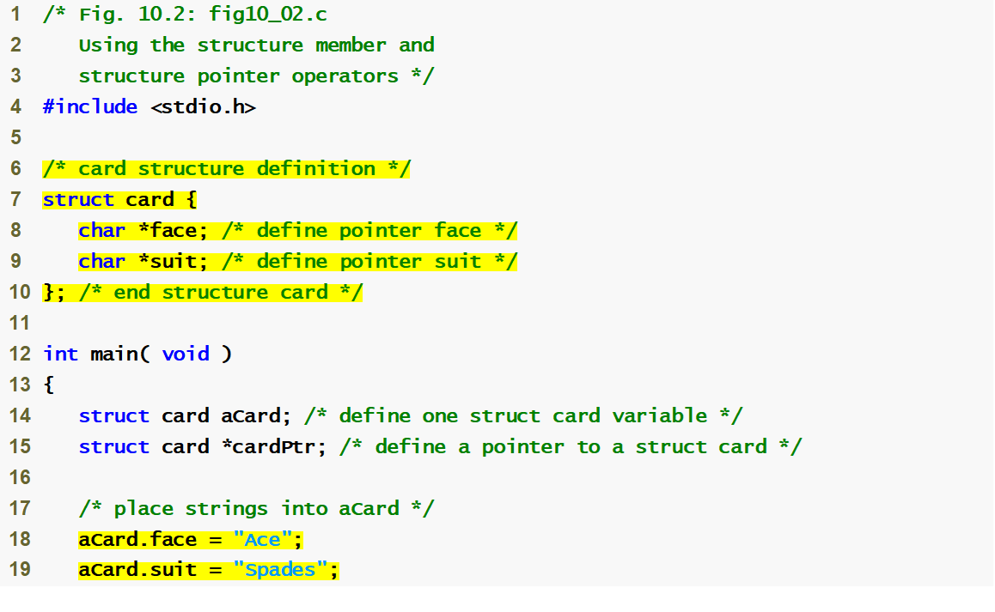
fig10_02.c
(1 of 2 )
Structure definition
Structure definition must end with semicolon
Dot operator accesses members of a structure

Slide 15
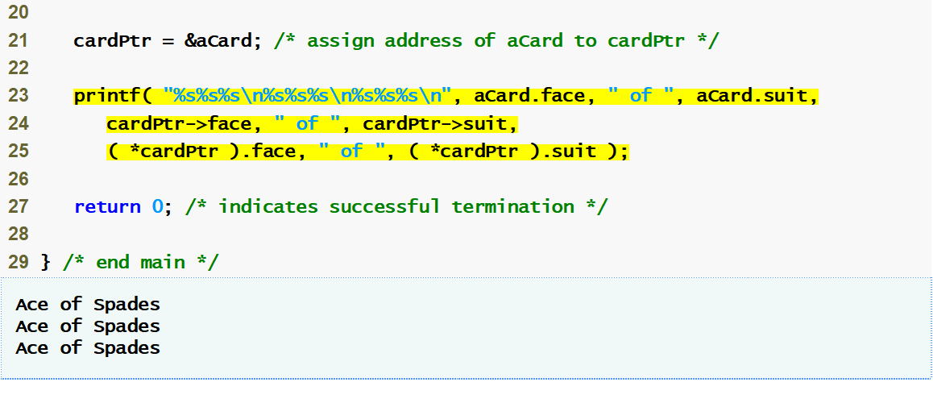
fig10_02.c
(2 of 2 )
Arrow operator accesses members of a structure pointer

Slide 16
Using Structures with Functions
Two ways to pass structures to functions
    Pass entire structure
    Pass individual members
    Both pass call-by-value
To pass structures call-by-reference
    Pass address
    Pass reference to structure

Slide 17
Using Structures with Functions
To pass arrays call-by-value
    Create structure with array as member
    Pass the structure
    Pass-by-reference more efficient

Slide 18
typedef
Keyword typedef
    Makes synonyms (aliases) for previously defined data types
        Does not create new type, only an alias
    Creates shorter type names
Example
    typedef Card *CardPtr;
    Defines new type name CardPtr as synonym for type Card *
        CardPtr myCardPtr;
        Card * myCardPtr;

